Slide 1
Performance Assessments
Update…
ACPS School Board Meeting
September 26, 2013

Slide 2
CAI 2013
Our purpose for tonight is to reconnect around the goal of creating a balanced assessment model that supports the development of lifelong learners.
This purpose is important because....
Notes:
Board priorities fit here…1.1, 1.3, 2.1 and 2.2 - Billy

Slide 3
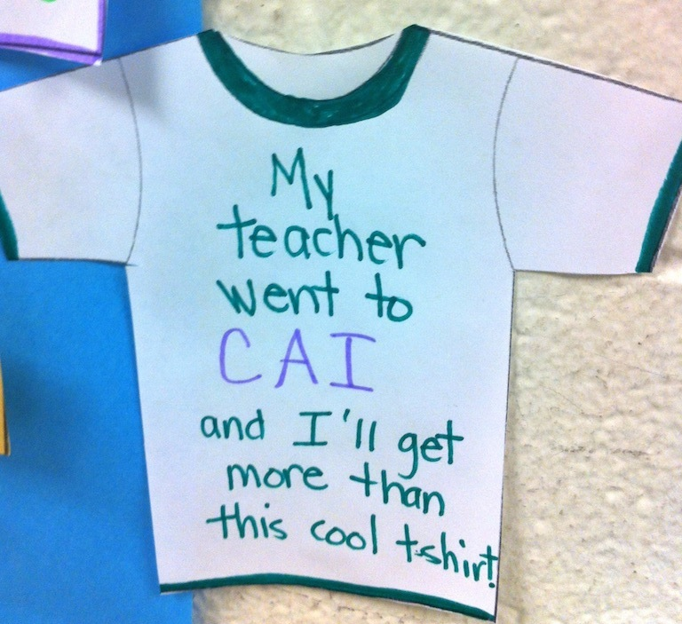
Remembering CAI

Slide 4
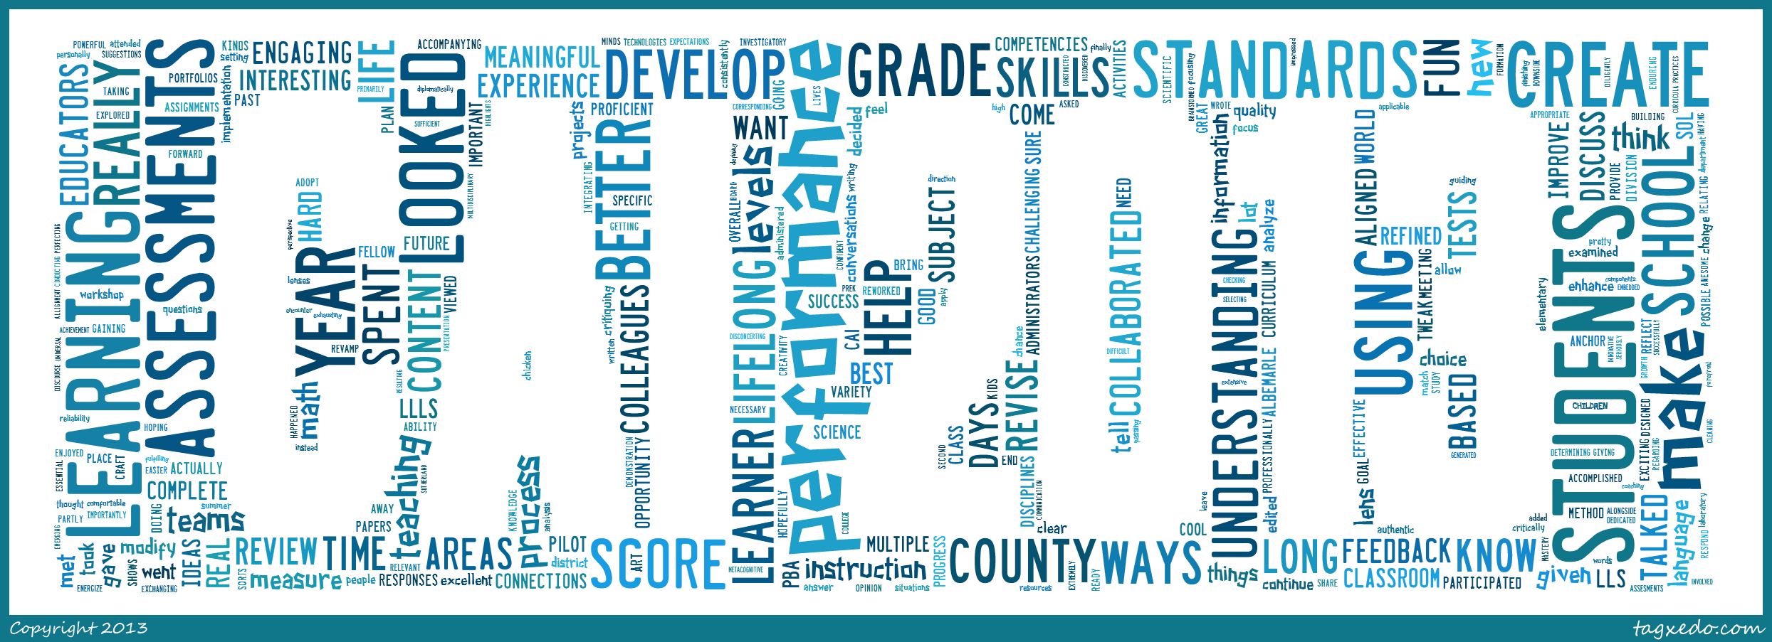
Remembering CAI
Notes:
This is what our teachers said about CAI…

Slide 5
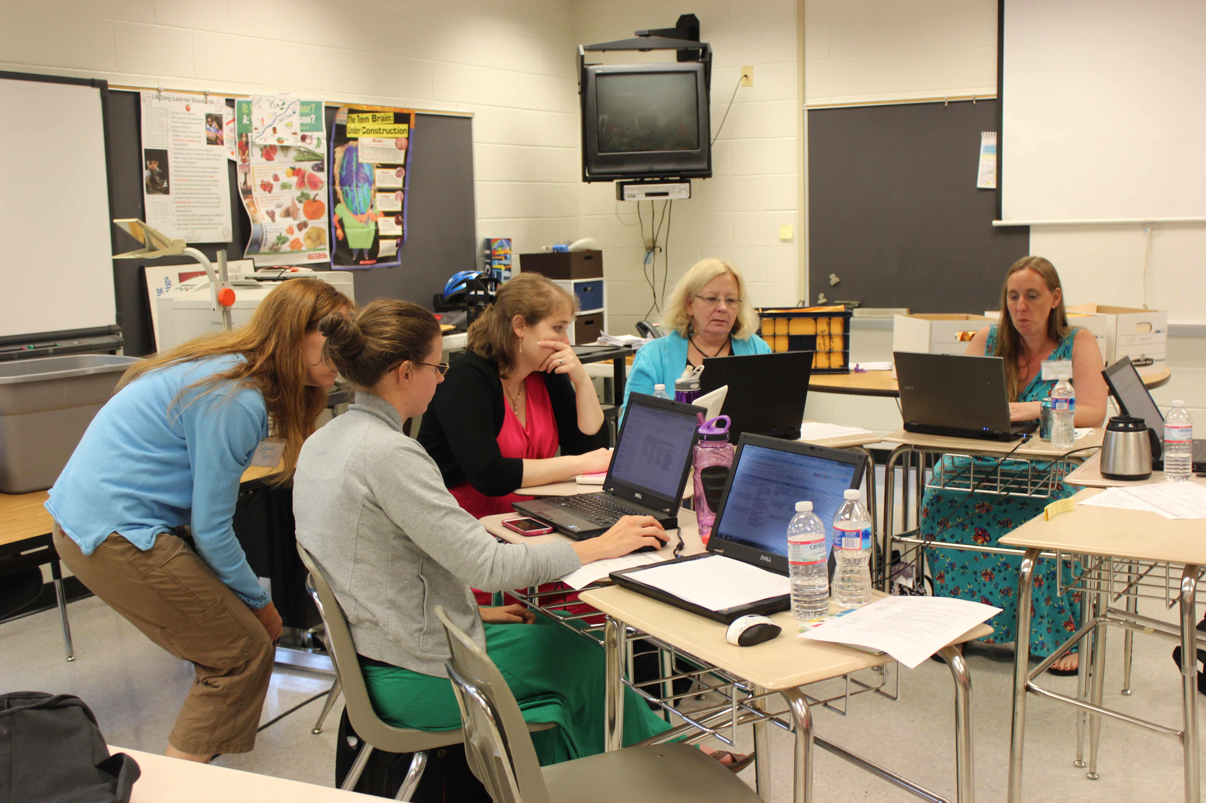
Remembering pre-service week…
“Today, you and other VT teammates from your school will be designing a “mini-CAI” learning experience for your school...think about what should be included? This will be your time to prepare for this Friday at your school.”
Notes:
August 13 the vertical teams met and created a lesson plan by school…

Slide 6
Conversations across schools
http://todaysmeet.com/aug16acps
http://storify.com/tborash/acps-assessing-for-quality-learning
Notes:
August 16 – taught the same lesson across school divisioni

Slide 7
Tasks
23 tasks to assess 11 Lifelong-Learner Standards
https://docs.google.com/a/k12albemarle.org/document/d/1Zkrbc6NnTMy-r3ciVPtrDXcN2VDVLHONLo5Bv5VnT58/edit
https://docs.google.com/a/k12albemarle.org/document/d/1WPur9lcsCv47YCcHpZ3ht7Usi6GiEPKO9JnVSIL-770/edit
Notes:
Adopt, abandon, adjust…

Slide 8
Next Steps for Tasks - 2013-14
This year’s administration
  Window is October 7th - April 14th
  Scoring to be done at division level by school teams that are interdisciplinary
  Score Collection process to be developed
  Able to report scores by LLLS
Will be reaching out to teachers for feedback on tasks and process
Notes:
This year’s administration
Administration window is October 7th - April 14th
Everything will be scored at schools - we are seeking your input on that scoring process
PLC scoring?
Grade level scoring?
Interdisciplinary team scoring?
Is there any reason a method would be better at one school than another?
Score Collection process TBD
What other questions do you anticipate your teachers might ask?

Slide 9
Questions…

